Slide 1
ONLINE INQUIRY AND BOOKING SYSTEM FOR SCENTA INC.
Galdo, John Angelo O.
Ungos, John Kevin N.

Slide 2
Introduction
Online Inquiry and Booking System For Scenta Inc

Slide 3
Online Inquiry and Booking System For Scenta Inc
Event management services accommodate a wide range of events including conferences, convention, concerts, trade shows, festivals, and ceremonies. It includes managing the team who is responsible for each function, the budget, and overseeing the execution of the event. There are different services that it offers to their client such as to plan and execute substantial company meetings and organize events such as sporting events, and reunions.

Slide 4
Background of the Problem
Online Inquiry and Booking System for Scenta Inc.

Slide 5
General Problem
Scenta Inc. is a event services company that supplies flower arrangement and event styling in Metro Manila and some other part of Luzon such as Laguna, Tagaytay and Cavite from 8 am to 5 pm. The problem that the customer usually encounters is the consistency of the data entry that effects the booking process. The proponents proposed a system that will help the company to make better and real-time transactions wherein a customer can easily change or update their booking without physically going to the office of Scenta Inc.
Online Inquiry and Booking System for Scenta Inc

Slide 6
Specific Problem
How to design and develop a module that will allow the clients to create an account?
How to design and develop a module that will allow the clients to inquire and book an event an event packages?
How to design and develop a payment module that will allow the clients to pay the availed packages though Paypal?
How to design and develop a gallery module that will advertise past successful events of the Scenta Inc.?
Online Inquiry and Booking System Scenta Inc.

Slide 7
How to integrate a live chat module that will serve as communication portal for the customer and Scenta Inc.?
How to design and develop a control panel module that will allow the admin to manage the information of the services offered, view customer informormation, modified the calendar and vacant booking request?
Online Inquiry and Booking System Scenta Inc.

Slide 8
Overview of the
current state of technology
Inquiry/Booking and A.L Signature Events
Online Inquiry and Booking System Scenta Inc.

Slide 9
Objective of the Study
General Objective
This system will help both the company and the clients to manage transactions efficiently. The aim of this study is to create a systematic process of inquiry and booking for Scenta Inc.
Online Inquiry and Booking System for Scenta Inc.

Slide 10
Specific Objectives
1.To design and develop a module that will allow the admin and the clients to create an account.
2.To design and develop a module that will allow the clients to set an appointment and to inquire and book an event packages.
3.To integrate a PayPal payment module that will allow the clients to pay the availed packages using PayPal.
Online Inquiry and Booking System for Scenta Inc.

Slide 11
4. To design and develop and a gallery module that will advertised past successful events of the Scenta Inc;
5. To integrate a live chat module that will serves as communication portal for the customers and Scenta Inc.;
6. To design and develop a control panel module that will allow the admin to manage the information of the services offered, view customer information, modified the calendar and vacant booking request.
Online Inquiry and Booking System for Scenta Inc

Slide 12
Scope and limitations of the study
Website
Home
Services
Gallery
Contact Us
Live chat
Online Reservation For Tandog Memorial Chapel

Slide 13
Administrator Side
Login
Dashboard
Services
Packages
Booking
Booking Calendar
Payment
Cancellation/Rebooking
Accounts
Client Account
Reports
Gallery
Online Reservation For Tandog Memorial Chapel

Slide 14
Limitation
1. The system will accept PayPal payments only.
2. The system will not handle refund transactions for the client.
3. The system will not handle the changed of availed event package.
4. The additional of services out of the event package cannot be handled by the system. The system will not provide selections of other services that is not within the package.
Online Inquiry and Booking System for Scenta Inc

Slide 15
Methodology
What is Modified Waterfall Model?
Online Reservation For Tandog Memorial Chapel

Slide 16
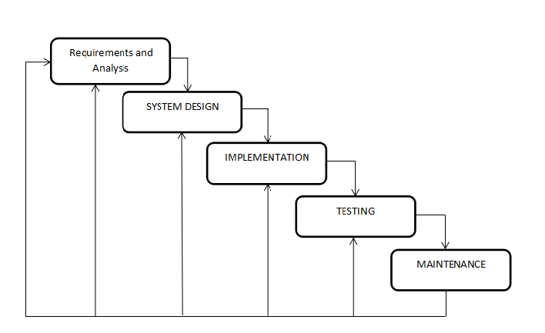
Methodology
Online Inquiry and Booking System for Scenta Inc

Slide 17
Thank you!
☺☺☺
Online Inquiry and Booking System for Scenta Inc

